Slide 1

AY-2025-2026
ODD SEM
Department of ECE
Analog electronic Circuit Design
23ec2104
Topic:
BJT CONSTRUCTION AND OPERATION
Session - 01

Slide 2
Session content
Si vs Ge, npn vs pnp
Unbiased BJT
Biased BJT
BJT Currents

Slide 3



AIM OF THE SESSION
To understand construction and operation of Bi-polar Junction Transistor
INSTRUCTIONAL OBJECTIVES
This Session is designed to:
  Understand the physical structure and biasing of BJT
  Understand current generation mechanism of BJT
  Understand operating modes of BJT
LEARNING OUTCOMES
At the end of this session, you should be able to:
  Demonstrate regions of n-p-n BJT
  Formulate BJT current equation
  Identify various modes of operation of BJT

Slide 4
Why bjt?
Completely Controlled Device
Current Source
Amplifier
Si vs Ge
npn vs pnp
Give your thoughts on energy band gaps and ease of availability for Silicon and Germanium
Electrons are lighter
Holes are heavier
Give your thoughts on which
devices can be faster

Slide 5
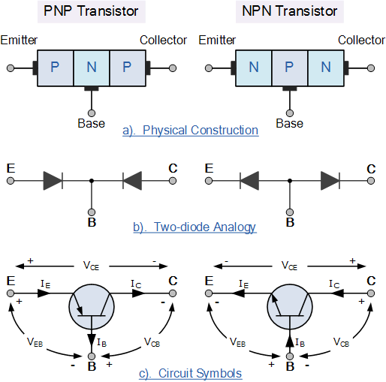
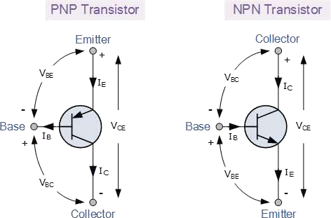
BJT

Slide 6

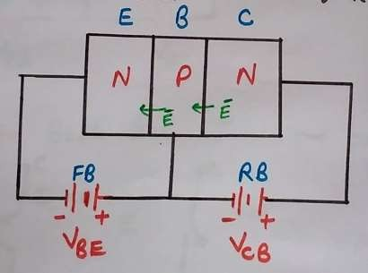
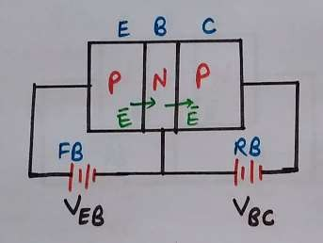
BJT
Operation Modes of BJT
*Active mode
*Saturation mode
*Cutoff mode
Active Mode Operation of BJT Transistor(NPN BJT)
Active Mode Operation of PNP BJT

Slide 7
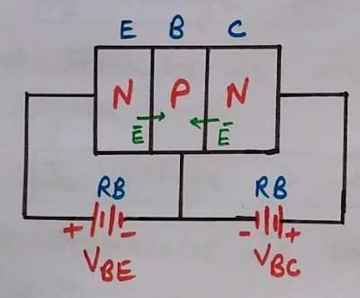
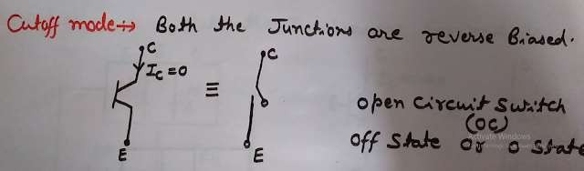
BJT
Operation Modes of BJT
*Active mode
*Saturation mode
*Cutoff mode
Cut off Mode Operation of BJT

Slide 8
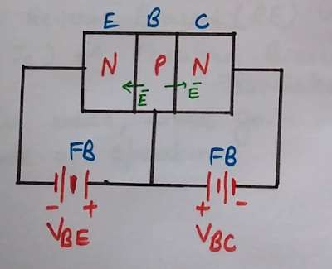
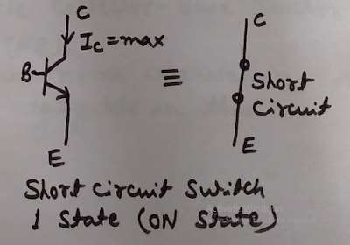
BJT
Operation Modes of BJT
*Active mode
*Saturation mode
*Cutoff mode
Saturation Mode Operation of BJT

Slide 9
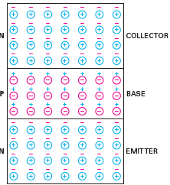
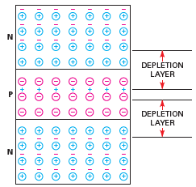
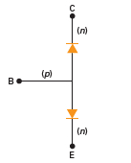
Unbiased bjt
Open Circuited npn BJT
Depletion Regions
Diode Equivalent Model
The BJT consists of three regions and two junctions
Emitter, base, collector for the regions of BJT
Volume wise C>E>>B
Doping wise E>C>>B
Two depletion regions as shown in Fig. 1.2 exists in open circuited BJT.
The depletion voltages differ as doping concentration varies from emitter and collector
The diode equivalent circuit notation is seen from Fig. 1.3 which depicts npn BJT as two diodes between Base-emitter and base-collector regions
Fig. 1.3. Equivalent diode
representation of BJT
Fig. 1.1. Open circuited npn BJT
Fig. 1.2. Depletion regions at B-E and B-C junctions of open circuited npn BJT

Slide 10
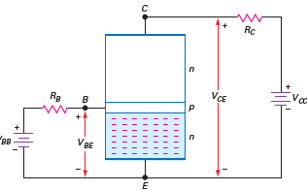
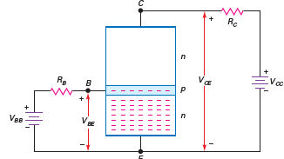
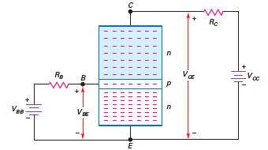
BIASED BJT
Provide proper External voltages
Free electrons in Emitter injected into Base
Electrons transported from Base to Collector
Fig. 1.4. Supplying external voltages to B-E and C-E terminals
Fig. 1.5. Forward biased BE junctions injects electrons in to base region
Fig. 1.6. Reverse biased BC junction transports electrons in to collector region
External voltages are provided such that B-E is FB and B-C is reverse biased.
The forward biased PN junction injects free electrons in to base region
As the base region is very small electrons are transported in to collector region through the reversed biased B-C junction at

Slide 11
Analogy with Transistor :Fluid-jet operated Valve
The fluid jet operated valve is shown with two valves.
First valve sets up the flow
Second valve control the flow
First valve position determine the volume of jet
Second valve determine its rate
This operation is analogous to BJT in the following manner
V_{CE} sets up the drift for charge carriers from emitter to collector and V_{BE} sets up diffusion of charge carriers in to collector region
Fig. 1.6. Depicting BJT operation analogous to fluid-jet operated valve

Slide 12
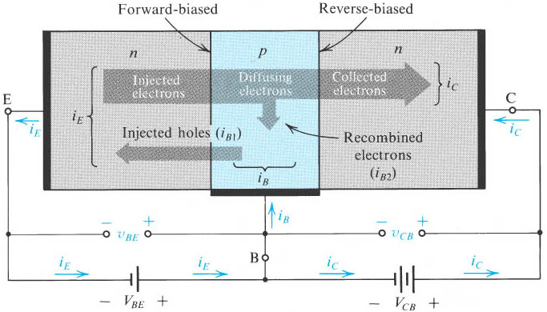
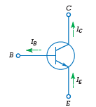
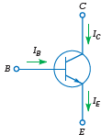
Total CURRENT in BIASED BJT
Fig. 1.7. Circuit symbol and flow of electrons in npn BJT
Fig. 1.8. Conventional current directions in npn BJT
Fig. 1.6. Currents in Biased BJT
Notes:
sedr42021_0503.jpg

Slide 13
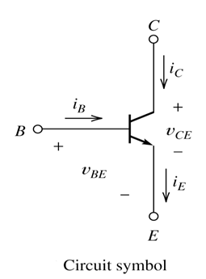
BJT CURRENTS
I_{E} – Largest emitter current
Emitter electrons flow to the collector, I_{C} ≈ I_{E}
I_{B} ≤ 0.01 I_{C}
KCL, I_{E} = I_{C} + I_{B}
Fig. 1.9. Conventional currents and voltages directions in npn BJT

Slide 14
BJT α and β
From Fig. 1. 9 I_{E} = I_{B} + I_{C}
Define α_{dc} = I_{C} / I_{E}
DC alpha is slightly less than 1
Low power transistor α_{dc} > 0.99 and High power transistor α_{dc} > 0.95
Define β_{dc} = I_{C} / I_{B} - known as a current gain

Slide 15
BJT α and β
Then β_{dc} = I_{C} / (I_{E} –I_{C}) = α_{dc} /(1- α_{dc})
Assignment – Derive α_{dc} = β_{dc} /(1+ β_{dc})
Then I_{C} = α_{dc} I_{E} & I_{B} = (1-α_{dc}) I_{E}

Slide 16
Example Problems
1.1 A BJT has a collector current of 10 mA and base current of 40 μA. What is the current gain of the transistor
Solution: β_{dc} = I_{C} / I_{B}
= 10 mA/40 μA
= 250
1.2 A BJT has current gain of 175. If the base current is 0.1 mA, what is the collector current?
Solution: β_{dc} = I_{C} / I_{B}
Therefore, I_{C} = β_{dc} I_{B}
= 175 * 0.1 mA
= 17.5 mA
1. 3 A BJT has current gain of 175. If the base current is 0.1 mA, what is the emitter current?
Solution: From above problem, I_{C} = 17.5 mA
Now, α_{dc} = β_{dc} /(1+ β_{dc}) implies α_{dc} = 0.004
And I_{C} = α_{dc} I_{E} implies I_{E} = I_{C}/α_{dc} = 17.5 mA/0.994 = 17.6 mA

Slide 17

SELF-ASSESSMENT QUESTIONS
BJT is modelled as
Voltage controlled voltage source
Current controlled voltage source
Current controlled current source
Voltage controlled current source
What is the current in BJT in cut-off region
β I_{B}
< β I_{B}
Zero

Slide 18
SELF-ASSESSMENT QUESTIONS
3. Which mode does BJT operate if B-E and B-C junctions are forward biased?
Saturation
Active
Cut-off
4. Which parameter shall be constant to plot input characteristics?
V_{CE}
V_{BE}
I_{C}
I_{B}

Slide 19
ANSWERS
C
C
A
A

Slide 20
TERMINAL QUESTIONS
Describe the regions and p-n junctions of bi-polar junction transistor.
Discuss the current mechanisms in BJT.
Obtain the expression for total current in BJT.
Draw the symbol of npn BJT and identify conventional current directions.
Derive the analogy between electron flow in BJT and jet flow in valve operated tube.
Obtain the relations between various current gains in BJT

Slide 21
REFERENCES FOR FURTHER LEARNING OF THE SESSION
Reference Books:
Albert Malvino, David Bate, “Electronic Principles”
Robert L. Boylestad and Louis Nashelsky - “Electronic Devices and Circuit Theory”

